Slide 1

MACHINE LEARNING
Logistic Regression
An Introduction to Supervised Classification Algorithm

Slide 2

Agenda
01
What is Logistic Regression
02
Key Terms
03
Scenarios and its Types
04
Derivation of Logistic Regression Equation
05
Demo
06
Applications of Logistic Regression
07
Performance of Logistic Regression
Models

Slide 3

The Definition
Logistic regression is the appropriate Regression Analysis to conduct when the dependent variable is Dichotomous (binary).
Like all regression analyses, the logistic regression is a predictive analysis.
Logistic regression is used to describe data and to explain the relationship between one dependent binary variable and one or more nominal, ordinal, interval variables.
Notes:
1. Binary means it can have only 2 values 0 or 1.
2. Binary in defined domain.
3. Nominal variables are used to “name,” or label a series of values.
4. Ordinal scales provide good information about the order of choices, such as in a customer satisfaction survey.
5. Interval scales give us the order of values + the ability to quantify the difference between each one.
6. Ratio scales give us the ultimate–order, interval values, plus the ability to calculate ratios since a “true zero” can be defined.

Slide 4

The Understanding
It is a classification algorithm.
It is a special case of linear regression where the outcome variable is categorical.
In other words, Logistic Regression seeks to model the probability of an event occuring depending on the values of independent variables where the dependent values can be either categorical or numerical.
It predicts the probability of occurance of an event by fitting data to a LOGIT (Log Odds) function.
Notes:
Logit function is a link where we would try to relate our independent variable which can be of any nature (Categorical or Numerical) to our outcome variable which is probability based.
In a nutshell, we do modelling, estimation, prediction and then finally the outcome is classification.

Slide 5




Categorical Variables
Probability
Variables related to categorical data are called categorical variables.
Categorical variables fall into three classifications: Nominal, Ordinal, and Interval
Probability P =
Outcome of interest
---------------------------
All possible outcomes
Key Terms
Odds
Logit Function
Odds =
P (occurring) = P
-------------------------------
P (not occurring) = 1- P
It links the independent variables to essentially the Bernoulli distribution ( the dependent variable)
Notes:
>> Odds are important as the derivation of logistic regression equation will depend on Odds. >> Bernoulli's distribution is a special case of bionomial theorem where the chances or outcome of the of event is 1 i.e. 0 or 1.

Slide 6



Exemplary Scenarios
To predict whether an
email is spam or not.
To predict whether a
tumor is malignant
or benign.
To predict a loan
defaulter.

Slide 7
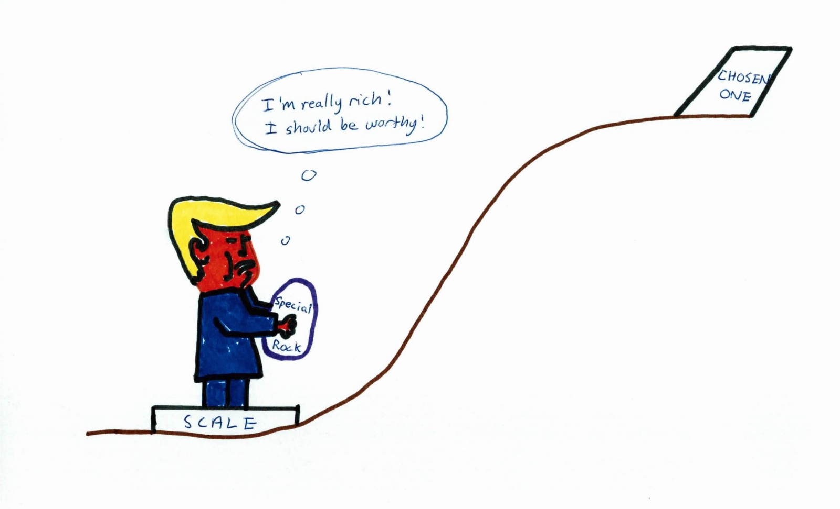
Why not Linear Regression?
Consider a scenario where we need to classify whether the tumor is malignant. If we use linear regression for this problem, there is a need for setting up a threshold based on which classification can be done. Say if the actual class is malignant, predicted continuous value 0.4 and the threshold value is 0.5, the data point will be classified as not malignant which can lead to serious consequence in real time.
From this example, it can be inferred that linear regression is not suitable for classification problem. Linear regression is unbounded, and this brings logistic regression into picture. Their value strictly ranges from 0 to 1.
Notes:
>> Linear regression is unbounded.
>> Data in the case of logistic regression is curvilinear.
>> In Linear regression, data should be normally distributed.
>> Linear regression violates the probability. Hence, it can not be used.

Slide 8

Major Assumptions in
Binary Logistic Regression
The dependent variable should be dichotomous in nature (e.g., presence vs. absent).
There should be no outliers in the data, which can be assessed by converting the continuous predictors to standardized scores, and removing values below -3.29 or greater than 3.29.
There should be no high correlations (multi collinearity) among the predictors. This can be assessed by a correlation matrix among the predictors. (Values higher than 0.9 should be removed)
Notes:
>> There should not be high collinearity among the predictor or independent variables.
>> As long correlation coefficients among independent variables are less than 0.90 the assumption is met.

Slide 9
Types of Logistic Regression
01
02
03
Binary
Logistic
Multinomial
Logistic
Ordinal
Logistic
The categorical response has only two 2 possible outcomes.
Example: Spam or Not
Three or more categories without ordering. Example: Predicting which food is preferred more (Veg, Non-Veg, Vegan)
Three or more categories with ordering.
Example: Movie rating from 1 to 5

Slide 10

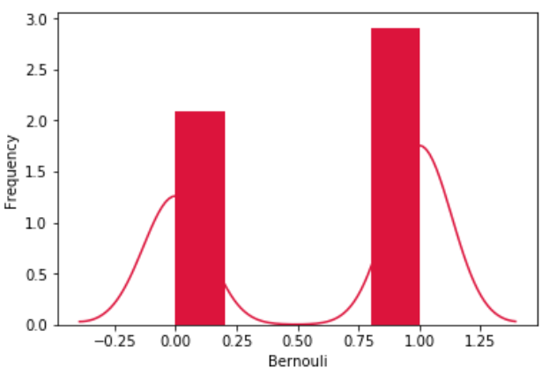
Derivation of Logistic
Regression Equation
The outcome in binomial logistic regression can be a 0 or 1.The idea is then to estimate the probability of an outcome being a 1 or a 0.
Given that the probability of the outcome is given by p then the probability of it not occurring is given by 1-p. This can be seen as a special case of Binomial distribution called the Bernoulli distribution.
The idea in logistic regression is to cast the problem in form of generalized linear regression model -
y^ = β0 + β1X1 + … + βnXn

Slide 11
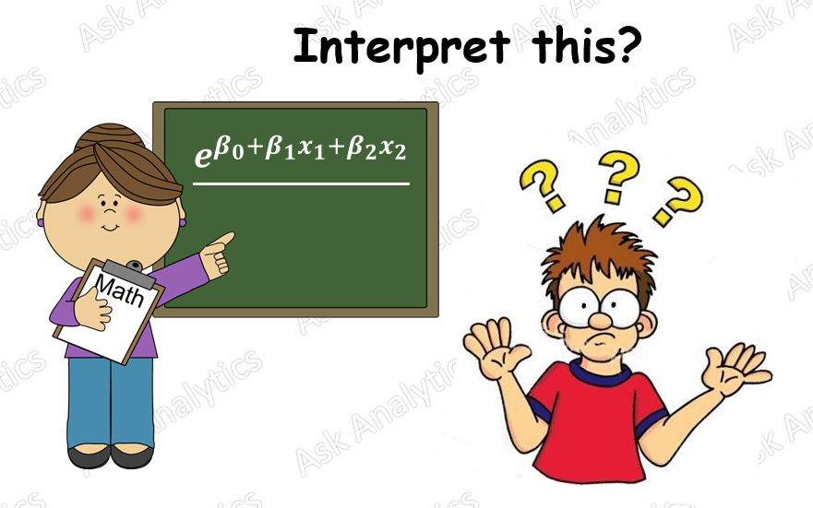
Derivation of Logistic
Regression Equation ...contd
y^=β0+β1X1+…+βnXn eq(1)
where y^ = predicted value.
Xn = independent variables.
βn = coefficients to be learnt.
Eq 1 can be transformed into vector form as
WT=[β0, β1, …, βn]
XT= [1, X1, …, Xn]
Then
y^= WT X

Slide 12
Derivation of Logistic
Regression Equation ...contd
But this is linear regression stuff so we need to find a way to cast the logistic regression problem in a manner whereby at least the expression above can be used. Thus if we compute the odds of the outcome as:
odds(p) = (p) / (1−p) eq(2)
We can move a step closer to casting the problem in a continuous linear manner but this is still just having positive values we need a range of (−∞,+∞)
That can be done by getting the (natural) logarithm of the odds as:
logit(p)=log[(p) / (1−p)] eq(3)
This now varies continuously linear and thus we can do the following:
logit(p)= y^= WT X eq(4)

Slide 13
Derivation of Logistic
Regression Equation ...contd
Thus the logit function acts like a link between logistic regression and linear regression and thus it is called a link function.
After we estimate the weights w we can take the inverse of logit to get the probability p as given below:
logit(p)=log[(p) / (1−p)]
Taking the natural exponential on both sides gives:
e^logit(p) = (p) / (1−p)
=> e^y = (p) / (1−p)
Adding 1 on both sides
=> e^y + 1 = [(p) / (1−p) ] + 1
=> e^y + 1 = 1 / (1−p)

Slide 14
Derivation of Logistic
Regression Equation ...contd
=> e^y + 1 = 1 / (1−p)
Changing subject of the formula to (1-p)
=> 1- p = 1 / 1 + e^y
Then subtracting 1 from both sides to give
=> - p = 1 / (1 + e^y) - 1
Multiplying by -1 from both sides to give
=> p = 1 - 1 / (1 + e^y)
=> p = e^y / (1 + e^y)
Dividing the numerator and denominator by e^y
p = 1 / 1+ e^-y This is Logistic (sigmoid) function

Slide 15

DEMO

Slide 16


Applications of Logistic Regression
Banking
Medical
Marketing
Banking
Medicine, assessing the risk of cardio-vascular disease based on current health and habits.
Marketers use it in examining whether a customer will respond to a particular ad based on preference of customer and type of web portal customer is active.
A credit card company can apply logistic regression to categorize the people in two types; good credit & bad credit based on the characteristics : annual salary, monthly credit card payments & no. of defaults.

Slide 17



Applications of Logistic Regression
GIS Image Processing
HR
Insurance
GIS Image
Processing
The HR manager of a company can predict the absenteeism pattern of his employees based on their individual characteristic
Insurance companies use logistic regression to predict the chances that the policy holder will die before the term of policy expires based on characteristics like gender, age and physical examination
Image segmentation and categorization.

Slide 18

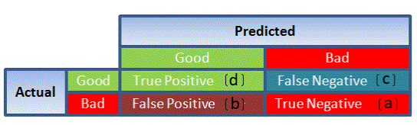
Performance Measurement of Logistic Regression
AIC (Akaike Value) :-
A non-parametric test since Logistic Regression does not assume Normality.
Measure of goodness of fit for the model.
Among competing models, the one with the least AIC value is selected.
Confusion Matrix:
It is nothing but a tabular representation of Actual vs Predicted values. This helps us to find the accuracy of the model. This is how it looks like:

Slide 19

Performance Measurement of Logistic Regression
Accuracy- The fraction of classifications that are correct. Accuracy is a commonly used evaluation measure in machine learning classification work
(TP + TN) / ( TP + FP + FN + TN)
Precision - Fraction of retrieved docs that are relevant = P(relevant|retrieved)
Precision (P) = TP/(TP + FP)
Recall - Fraction of relevant docs that are retrieved = P(retrieved|relevant)
Recall (R) = TP/(TP + FN)
F1 Score – Useful when dataset is imbalanced. F1 Score is the harmonic mean of precision and recall.
Precison X Recall
F1 Score = 2 X --------------------------
Precision + Recall

Slide 20

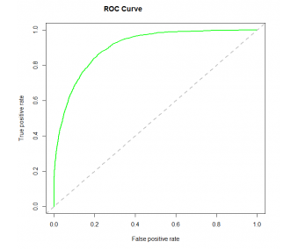
Performance Measurement of Logistic Regression
ROC Curve:
Receiver Operating Characteristic(ROC) summarizes the model’s performance by evaluating the trade offs between true positive rate (sensitivity) and false positive rate(1- specificity).
For plotting ROC, it is advisable to assume p > 0.5 since we are more concerned about success rate. ROC summarizes the predictive power for all possible values of p > 0.5

Slide 21

T H A N K S
Vishal Kumar
Data Scientist - Vehicle Diagnostics
LinkedIn - https://www.linkedin.com/in/vishal5164/

